Slide 1
Accessible Beaches - FY21 Annual Financial Statements
Balance Sheet
Profit & Loss
Cash Flow Summary

Slide 2
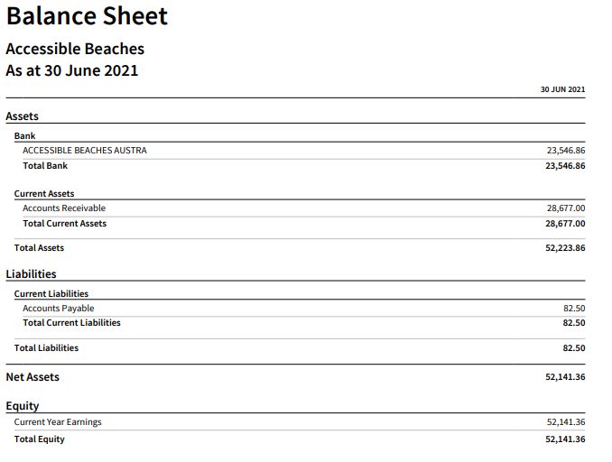

Slide 3
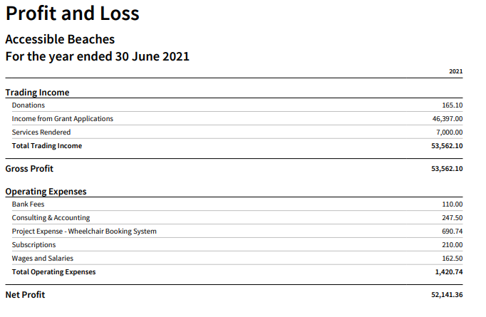

Slide 4
